Slide 1
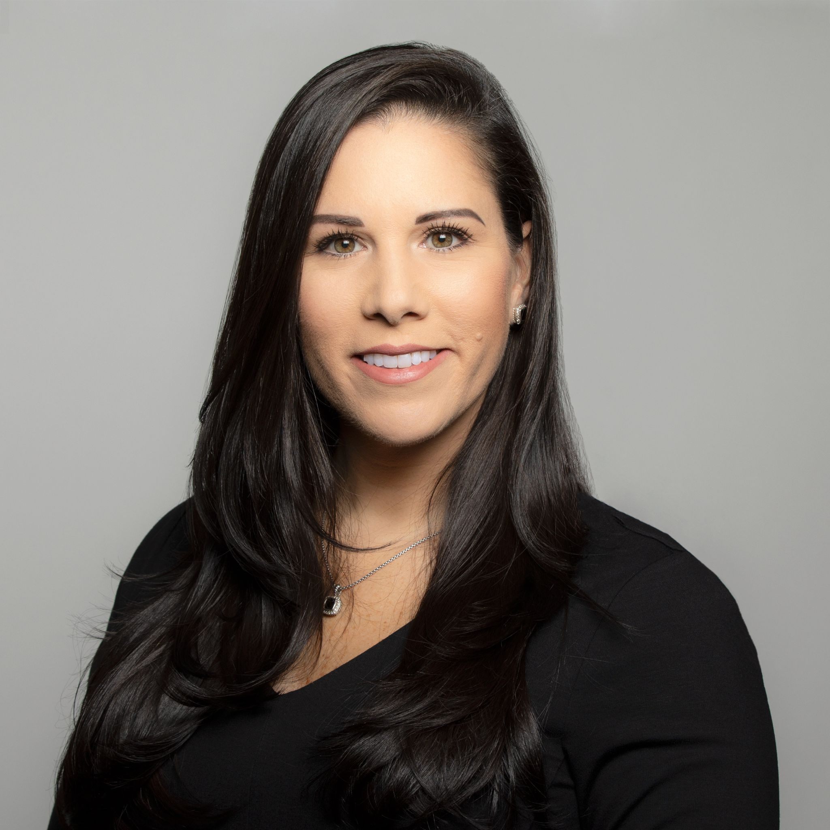
CUSTOMER SUCCESS LEADERSHIP BOOTCAMP
PART V: ARCHITECTING YOUR CS INTERVIEW PROCESS
KRISTI FALTORUSSO
VP of Customer Success
ClientSuccess
TUESDAY, AUGUST 31, 2021
1PM EST/ 10AM PST
brought to you by

Slide 2
THE IMPACT OF HIRING THE RIGHT PEOPLE
REDUCES
TURNOVER
COSTS
POSITIVE MORALE
FOSTERS BUSINESS GROWTH
BRAND IMAGE
SAVES TIME
MAXIMIZE PRODUCTIVITY

Slide 3
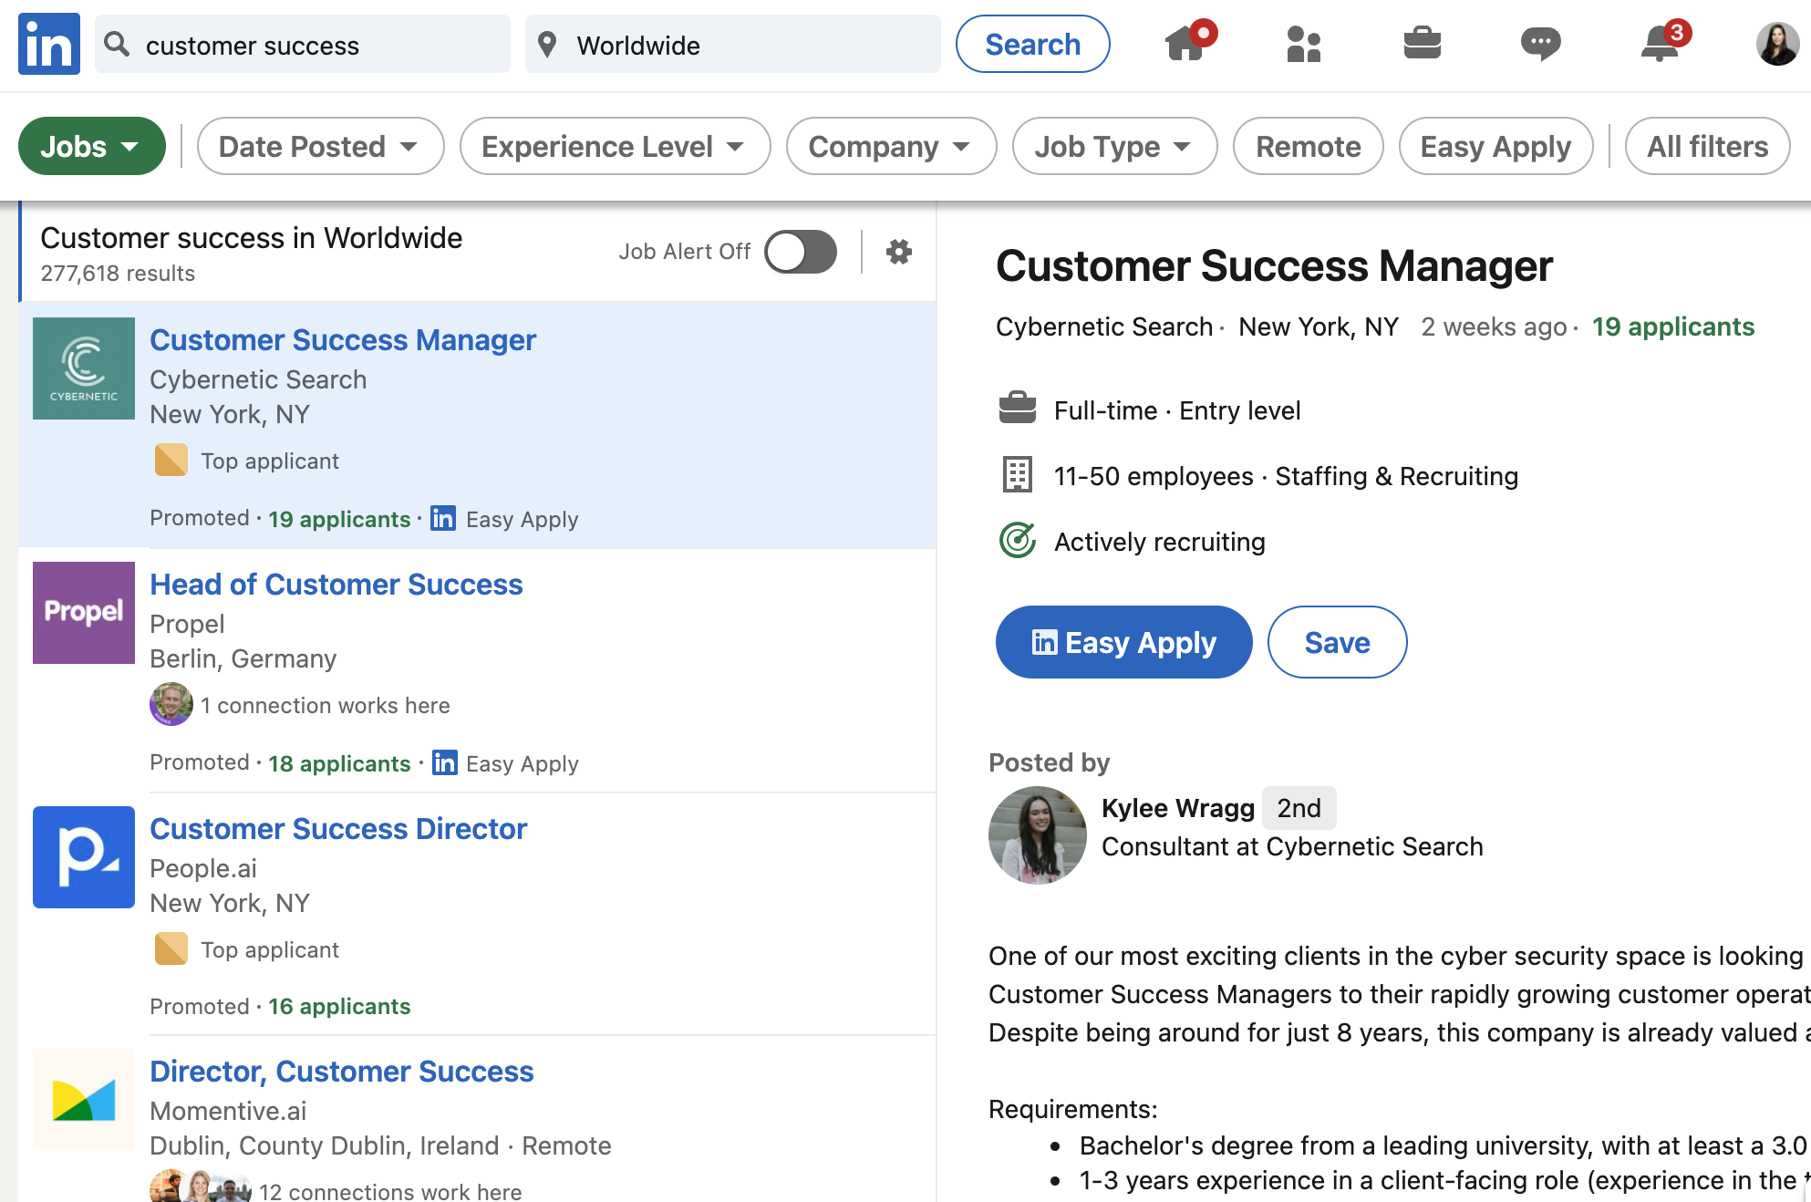
THE MARKET IS COMPETITIVE

Slide 4
DESIGNING YOUR JOB DESCRIPTION
Writing your job description is step 1 and if you do this well you will draw in many qualified, strong fit applicants. So what should you include in your job description:
Why You Should Work With Us — All about your company and why it’s the best place to work - What makes your company special
Position Details — A grand overview of the position and what the role is all about - Tell a story about the day-to-day
Position Competencies — Experiences / skillsets / traits required
Position Outcomes — What the applicant will be directly responsible for - What impact can they make on the company

Slide 5
ANATOMY OF AN EFFECTIVE INTERVIEW
EXPECTATIONS
1
2
COMMUNICATION
Set proper expectations with the candidate from the beginning to the end.
Ensure effective communication with your candidate throughout the process.
TIMELINE
PREPAREDNESS
Establish timelines for each stage and ultimately your decision making.
Prepare for your discussions with the candidate to make the best use of everyone’s time.
4
3

Slide 6
GETTING STARTED
TIME ALLOCATION: 25 - 30 minutes
OBJECTIVE: Establish mutual fit for the candidate and the role
INTERVIEWER: Recruiter OR Hiring Manager
DISCUSSION: Introductions, Company & Role, Experience Overview, Alignment, Compensation, Starting Timeline, Competing Opportunities
ASSESSMENT: Does this candidate have the right experience and skill set to be successful in the role? Does this role align with with what the candidate is looking for? Can they be successful in this role?

Slide 7
INTERVIEW WITH IMPACT
CUSTOMER SUCCESS + MARKETING
CULTURE FIT
01
02
03
04
05
CUSTOMER SUCCESS DEEPDIVE
CUSTOMER
SUCCESS + SALES
PRESENTATION +
Q&A

Slide 8
INTERVIEW STAGES
TIME ALLOCATION: 50 minutes
OBJECTIVE: This candidate can effectively manage customer situations
INTERVIEWER: Hiring Manager
DISCUSSION: Behavioral style questions focused on navigating customer situations; Q&A
ASSESSMENT: Does this candidate know how to run best practices in Customer Success? How do they handle objections? Are they solutions oriented? Do they have the right technical aptitude? Strong communication and time management skills?
01
CUSTOMER SUCCESS DEEPDIVE

Slide 9
INTERVIEW WITH IMPACT
CULTURE FIT
TIME ALLOCATION: 25 - 30 minutes
OBJECTIVE: Will this candidate be able to effectively ramp into your organization
INTERVIEWER: Member of the Customer Success Team
DISCUSSION: Behavioral style questions focused on onboarding, ownership and collaboration; Q&A
ASSESSMENT: Does this candidate have the right drive and initiative to be successful in your organization? Will they work collaboratively with cross-functional teams? Experience with project/program management?
02

Slide 10
INTERVIEW WITH IMPACT
TIME ALLOCATION: 25 - 30 minutes
OBJECTIVE: Will this candidate be able to manage the commercial aspects of the partnership
INTERVIEWER: Member of the Sales organization
DISCUSSION: Behavioral style questions focused on renewal management, negotiation, opportunity identification, lead generation; Q&A
ASSESSMENT: Does this candidate have experience managing renewals, upsells, cross-sells and expansions? Do they have strong negotiation skills? Ability to manage objection handling? Do they know how to conduct good discovery?
03
CUSTOMER
SUCCESS + SALES

Slide 11
INTERVIEW WITH IMPACT
CUSTOMER SUCCESS + MARKETING
TIME ALLOCATION: 25 - 30 minutes
OBJECTIVE: Candidate will be able to facilitate marketing initiatives through customer partnership
INTERVIEWER: Member of the Marketing organization OR Customer Marketing
DISCUSSION: Behavioral style questions focused on reference programs, case studies, field events, and customer advocacy initiatives; Q&A
ASSESSMENT: Does this candidate know how to build brand advocates? Do they know how to maximize the value of customer champions? Are they comfortable asking for customer participation and feedback?
04

Slide 12
INTERVIEW WITH IMPACT
TIME ALLOCATION: 50 minutes
OBJECTIVE: Can the candidate strategically manage a book of business support retention, growth and advocacy
INTERVIEWER: Hiring Manager AND another member of the Customer Success team
DISCUSSION: Candidate to present the assignment; Q&A
ASSESSMENT: Does this candidate understand how to manage risk and capitalize on opportunity? Do they have the ability to this strategically to support the future of the partnership? Strong presentation skills? Good call control? Did they ask good and thoughtful questions?
05
PRESENTATION +
Q&A

Slide 13
DO’S AND DON’TS OF INTERVIEWING
DO’S
DON’TS
Spend time reviewing applicant resumes and share feedback with your recruiting team
Have the recruiting team define the interview process for your candidates
Get various stakeholders involved in the interview process to support cross-functional buy-in
Hop on a call with a candidate without reviewing their resume and LinkedIn profile
Reply to thank you follow up emails; this will illustrate your appreciation for the candidates time
Ask the same questions at every stage in the process
Set proper expectations with the candidate at every stage and around decision making timelines
Forget to review notes from the previous interviews to go deeper where gaps are identified
Give feedback if a candidate is not advancing to next stages; gaps in experience, communication etc.
Give candidates fales hope or lead them to believe they are the lead candidate if they are not

Slide 14
EFFECTIVE INTERVIEWING
TO SCALE

Slide 15
INTERVIEW TIPS
1.
2.
3.
4.
5.
ALIGN WITH THE INTERVIEW PANEL ON ROLES AND ASSESSMENT CRITERIA
PRE-WRITE ALL OF YOUR INTERVIEW QUESTIONS AND SHARE THEM WITH THE PANEL
BLOCK TIME ON THE CALENDAR FOR ALL OF THE PANEL MEMBERS FOR EASE OF SCHEDULING
SET A 2 HOUR WINDOW TO RECEIVE FEEDBACK ON THE CANDIDATES TO FACILITATE SPEED
DON’T SIT ON STRONG CANDIDATES IN A HOT MARKET; MOVE FAST TO OFFER

Slide 16
JUST WHEN YOU
THINK IT’S OVER ...

Slide 17
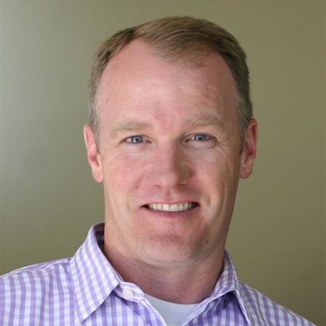
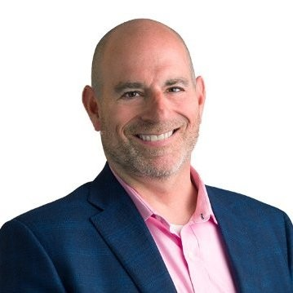
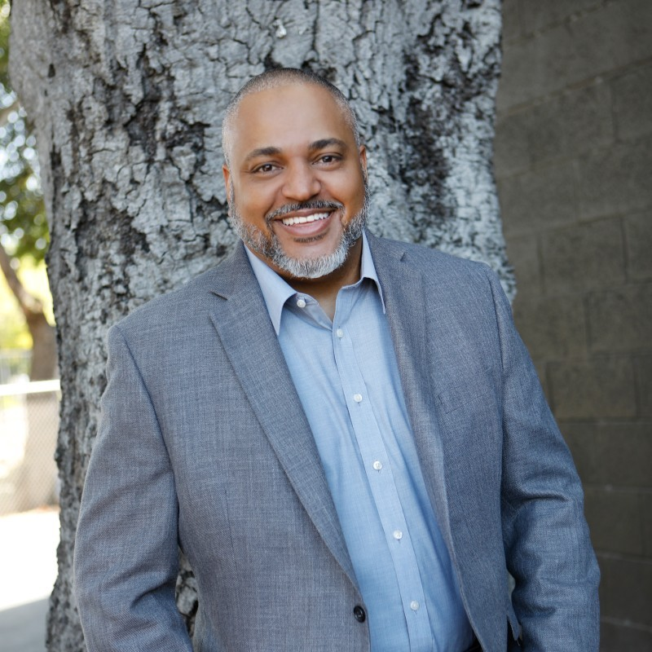
SEPTEMBER’S WEBINAR LINE UP
9/7: Post Leadership Bootcamp Q&A with Kristi and Dave
9/14: Bob London - How to Have More Strategic Customer Conversations
9/21: TBD
9/28: Charles Coaxum - Managing Customer Success Through and Acquisition
TBD

Slide 18
WE’RE COMING BACK FOR MORE
Customer Success Leadership Bootcamp Webinar Series -
Fall 2021 Edition
Every Tuesday in October at
1pm EST / 10am PST
10/5: How to Execute a Customer Objectives Review Meeting (COR) that Executives Will Want to Attend
10/12: Executing Account Transitions that Excite Customers and Reduce Risk
10/19: Customer Offboarding and Exit Interviews to End on a High Note
10/26: Designing a Voice of Customer Program to Power Your Future
KRISTI FALTORUSSO
VP OF CUSTOMER SUCCESS
CLIENTSUCCESS

Slide 19
Q
&
A

